Slide 1
Hacking, History and Spaces
Lecture 8

Slide 2
What is Hacking and Ethical Hacking?
Hacking refers to the act of gaining unauthorized access to computer systems, networks, or digital devices with the intention of exploiting vulnerabilities, manipulating data, or carrying out other malicious activities.
Ethical hacking, on the other hand, refers to hacking carried out with proper authorization and for legitimate purposes. Ethical hackers, also known as "white hat hackers" or "security researchers," use their skills and knowledge to identify vulnerabilities and weaknesses in systems, networks, or applications.

Slide 3
Who is a Hacker?
A hacker is a skilled individual who uses their technical knowledge and expertise to gain unauthorized access to computer systems or networks, often with the intention of exploring, exploiting, or manipulating them for various purposes, both ethical and malicious.
The term "hacker" originated at the Massachusetts Institute of Technology (MIT) in the early 1960s. The first known hacker is widely considered to be MIT student Alan Kotok, who, along with a group of students, created the "Hacker's Dictionary" (also known as the "Jargon File") in 1963. This was a collection of technical terms and jargon used by early computer enthusiasts and programmers

Slide 4

The First Hacker In The History
John Draper, also known as Captain Crunch, is often named as the first ever hacker. And rather than having lots of high-tech hacking tools at his disposal, he managed to do it all with a toy whistle from a cereal packet. Here’s how:
Back in the early 1970s, the largest computer network accessible to the general public was the telephone system. And at the time, telephones were managed by an automated system that used specific analogue frequencies to place calls. Draper managed to exploit this using a toy whistle that came free in boxes of Cap’n Crunch cereal (hence the nickname). He would use this to make free long distance and international calls. This technique was known as “Phreaking”.

Slide 5

The First Internet Hacker
One of the first internet hackers, and certainly the first to gain mainstream media attention, was Robert Morris back in 1989. His was the first “Denial of service” attack in history and it was caused by a worm Morris had developed at Cornell University the year before.
According to Morris, he didn’t intend to cause any harm, but rather to highlight security flaws. But unfortunately, due to a fault in the code, the worm replicated excessively, causing extensive damage that lasted for days.

Slide 6
The History Of Hacking
Early Exploration (1960s-1970s) In the 1960s and 1970s, hacking had a more benign connotation and was associated with curiosity and exploration. Hackers were often individuals who sought to understand and push the boundaries of computer systems and networks. Some notable figures during this time include MIT's Tech Model Railroad Club (TMRC) and the Homebrew Computer Club.
Phone Phreaking (1970s) Phone phreaking emerged as a precursor to computer hacking. Phone phreaks discovered vulnerabilities in the phone system, enabling them to make free long-distance calls or access restricted systems. Famous phone phreaks like John Draper, known as "Captain Crunch," gained attention during this period.
Rise of Computer Hacking (1980s) The 1980s saw the rise of computer hacking as personal computers became more accessible. Hacking communities like The Legion of Doom and Chaos Computer Club emerged, exploring system vulnerabilities and exchanging knowledge. Notable hackers during this time include Kevin Mitnick and Gary McKinnon.

Slide 7
The History Of Hacking (Cont.)
Widespread Internet Access (1990s) The widespread adoption of the internet in the 1990s opened up new opportunities and challenges for hackers. The advent of the World Wide Web and increased connectivity led to a surge in cybercrime and hacking incidents. The term "black hat" emerged to describe hackers with malicious intent.
Hacktivism and Cyber Warfare (2000s) The 2000s witnessed the emergence of hacktivism, where hackers targeted organizations or governments to promote social or political causes. Groups like Anonymous gained prominence for their online activism. Additionally, nation-states started utilizing cyber attacks for espionage, sabotage, or disruption.
Modern Era (2010s and Beyond) The modern era of hacking has seen a significant increase in the scale, sophistication, and impact of cyber attacks. Ransomware attacks, data breaches, advanced persistent threats, and state-sponsored hacking have become more prevalent. The focus on cybersecurity has grown, and ethical hacking has gained recognition as a profession.

Slide 8
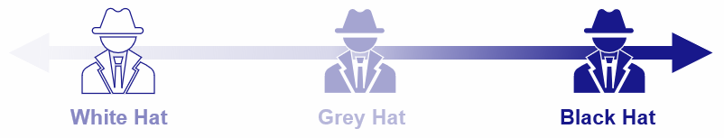
Types of Hacker
1. Black Hat Hackers Black hat hackers, also known as "crackers," engage in hacking activities with malicious intent. They exploit vulnerabilities, breach security defenses, steal sensitive information, carry out cyberattacks, or cause disruption for personal gain, financial profit, or to create chaos.
2. White Hat Hackers White hat hackers, also referred to as "ethical hackers" or "security researchers," work legally and ethically to identify vulnerabilities and improve security. They help organizations by conducting authorized penetration testing, vulnerability assessments, and providing recommendations to enhance security defenses.
3. Grey Hat Hackers Grey hat hackers fall somewhere between black hat and white hat hackers. They may uncover vulnerabilities without explicit permission but may notify the affected organization afterward. While their intentions may be good, their methods may still be illegal or unauthorized.

Slide 9

The Color Wheel of Information Security
The Information Security Color Wheel a multicolored circular graphic that represents various fields in Information Security. Broadly, the color wheel in Information Security has seven colors – primary colors such as red, blue and yellow; secondary colors that are a combination of primary – purple, orange and green; and white.
The cybersecurity color wheel was created by April C. Wright in 2017, who wrote a complete paper on color wheel to expand and highlight different fields of cybersecurity. Traditionally, cybersecurity fields were limited to blue and red. Considering the growing teams in the field, it has now expanded beyond these basic primary colors.
April C Wright

Slide 10
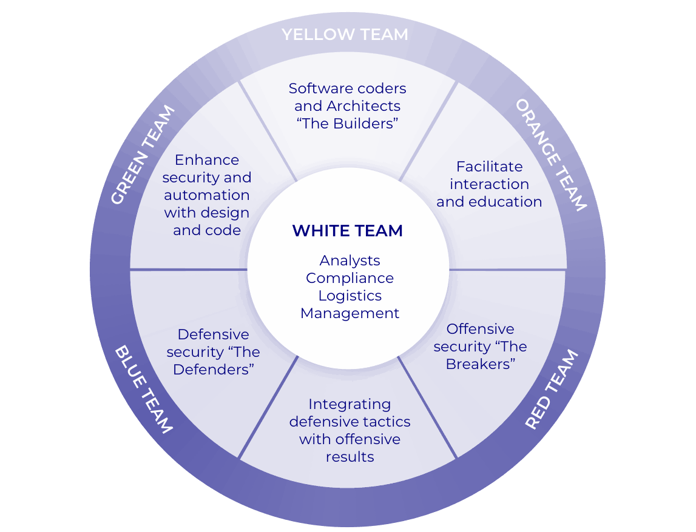
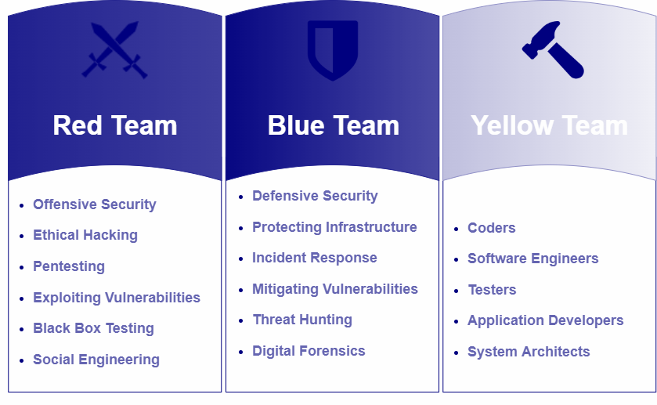
The Color Wheel

Slide 11
Red, Blue and Yellow Team
Red Team Offensive Security: Represents the actions and strategies used by ethical hackers and penetration testers to identify vulnerabilities and weaknesses in systems, networks, and applications.
Blue Team Defensive Security: Symbolizes the protective measures put in place to defend against cyber threats, such as firewalls, antivirus software, and intrusion detection systems.
Yellow Team The Builders: The team is responsible for developing the security system of an organization. They could be an in-house IT department or a third-party security solutions provider. They may also be app or software developers, who are expected to ascertain that their applications are adequately secure.

Slide 12
Key Difference Between Cybersecurity And Information Security
In short, the key difference between Cybersecurity and Information Security is their scope:
Cybersecurity primarily focuses on protecting computer systems, networks, and data from cyber threats and attacks that occur in the digital realm (cyberspace).
Information Security, on the other hand, has a broader scope and encompasses the protection of all forms of information, including physical and digital data, regardless of the medium through which it is stored or transmitted.
In summary, Cybersecurity deals specifically with digital threats in cyberspace, while Information Security covers a wider range of information protection, both digital and physical.

Slide 13
Cyber security vs information security
Cybersecurity and information security are related concepts that focus on protecting digital assets and mitigating risks, but they have slightly different scopes and emphases:
Cybersecurity: Cybersecurity primarily deals with protecting computer systems, networks, and digital infrastructure from cyber threats. It encompasses measures and practices that aim to prevent unauthorized access, protect against cyberattacks, and ensure the confidentiality, integrity, and availability of digital assets. Cybersecurity focuses on defending against threats specific to the digital realm, such as malware, hacking, phishing, ransomware, and other cyber threats.

Slide 14
Cyber security vs information security (Cont.)
Information Security: Information security has a broader scope and encompasses the protection of all forms of information, whether in digital or physical form. It involves safeguarding the confidentiality, integrity, and availability of information assets, regardless of the medium in which they are stored or transmitted. Information security addresses the protection of information from unauthorized access, disclosure, alteration, destruction, and other risks. It includes not only cybersecurity measures but also physical security controls, personnel security, risk management, and compliance with regulations and policies.
In summary, cybersecurity is a subset of information security that specifically focuses on protecting digital assets from cyber threats. Information security, on the other hand, encompasses the protection of all forms of information, both digital and non-digital, and encompasses cybersecurity as one of its components.

Slide 15
Questions

Slide 16
Thanks!

